Slide 1
US Election Prediction Markets:
Applications of Parimutuel Call Auction Mechanisms
Mark Peters
November 25, 2006

Slide 2
Agenda
2006 US Elections
  Our experience
  Other markets
Convex Parimutuel Call Auction Mechanism (CPCAM)
  Positive characteristics
  Issues

Slide 3
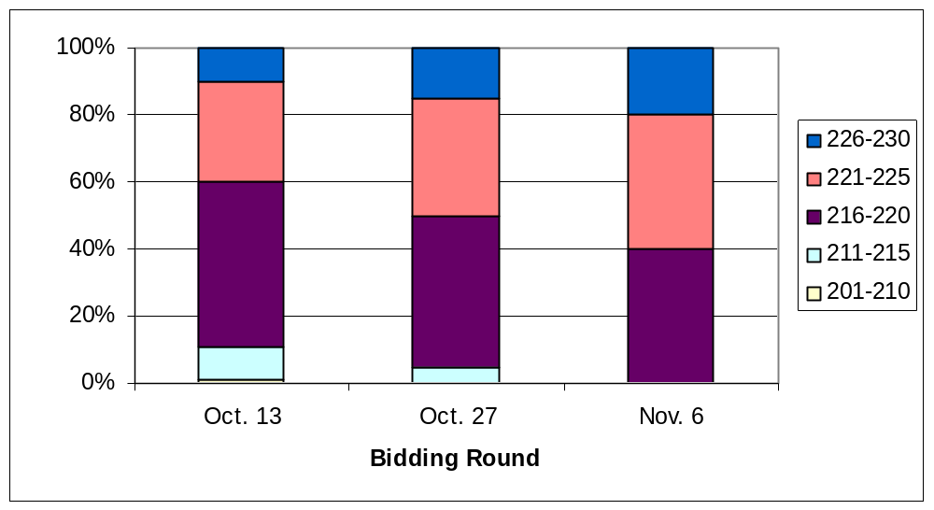
MS&E 211 Election Auction
As the election drew closer, the class estimated that the Democrats would win more seats.
Number of Seats in House Won by Democrats
Actual outcome: Democrats win ~ 232 seats

Slide 4
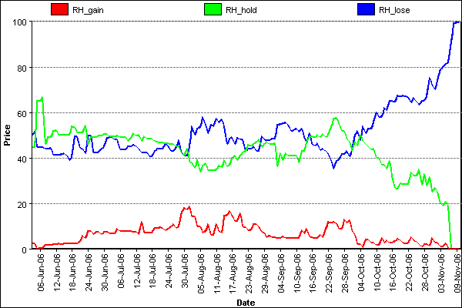
Iowa Election Market
The University of Iowa runs a real-money prediction market on elections. The blue line represents the probability that the Democrats win control of the House.
2006 US House of Representatives Election
Election Day
84% chance that Democrats win the House
Mark Foley scandal hits

Slide 5
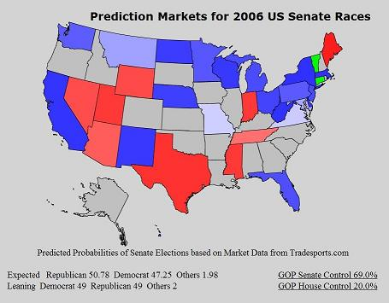
Tradesports
Tradesports is a betting site that allows people to wager on political events. The map below shows predictions for the 2006 US Senate races. All predictions turned out to be correct.
Lance Fortnow’s Election Map on Election Day morning
Bright red is likely Republican win
Pink is probable Republican win
Light blue is a probable Democrat win
Bright blue is likely Democrat win
Green is Independent win
Election Day
80% chance that Democrats win the House

Slide 6
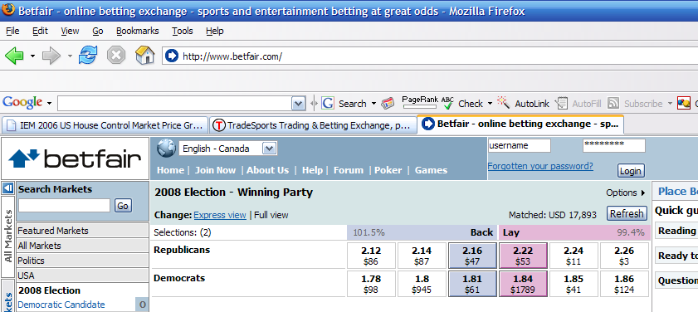
Betfair.com
2008 US Presidential Election – winning party
Implied probability of Democrats winning ~55%

Slide 7
Other Prediction Markets
Market | Description | Mechanism | Money
InklingMarkets | Service for individuals or companies to create prediction markets | LMSR | No
Washington Stock Exchange | Predictions about various political events | LMSR | No
BizPredict | Predictions about various business events (earnings, new products, etc.) | LMSR | No
Yahoo! Tech Buzz Game | Prediction market for “high tech products, concepts and trends” | DPM | No
Hurricane Futures Market | Predictions on where hurricanes will hit the U.S. | Continuous Double Auction | Yes
Note: LMSR is the Logarithmic Market Scoring Rule developed by Hanson (2003) and DPM is the Dynamic Parimutuel Market Maker by Pennock (2004)

Slide 8
Agenda
2006 US Elections
  Various markets
  Our experience
Convex Parimutuel Call Auction Mechanism (CPCAM)
  Positive characteristics
  Issues

Slide 9
General Markets for Contingent Claims
Our Contingent Claim Market
  S possible states of the world (one will be realized)
  Participants who submit orders to a market organizer containing the following information:
    State bid (either 1 or 0)
    Limit quantity
    Limit price
  One market organizer who will determine the following:
    State price
    Order fill
  Call auction mechanism is used – organizer receives orders until a certain time when the market is closed and the organizer determines which orders to accept
  If Order is accepted and correct state is realized, the organizer will pay the participant a fixed amount w
Examples
  Options markets – GS and Deutsche Bank’s market on economic indicators
  Betting – World Cup, NFL Playoffs
  Prediction markets

Slide 10
World Cup Betting Example
Market for World Cup Winner
  Assume 5 teams have a chance to win the 2006 World Cup
    Argentina, Brazil, England, Germany and Italy
  We’d like to create a market where participants trade contingent claims over the winner of the World Cup
  We’d like to have a standard payout of $1 if a participant has a claim where his selected team won
  Participants can place an order containing a single team or a group of teams (reflecting your beliefs of who will win the tournament)
Sample Orders
Order Number | Price Limit | Quantity Limit | Argentina | Brazil | England | Germany | Italy
1 | 0.75 | 10 | 1 | 1 | 1
2 | 0.35 | 5 |  |  |  | 1
3 | 0.40 | 10 | 1 |  | 1 |  | 1
4 | 0.95 | 10 | 1 | 1 | 1 | 1
5 | 0.75 | 5 |  | 1 |  | 1

Slide 11
Options for Creating the World Cup Market
Let participants trade directly with one another
  Requires participants to find someone to take the other side of their order (i.e.: the complement of the set of teams which they have selected)
  This may be an appropriate method for markets with small number of states and large number of participants
Centrally organize the market
  Introduce a market organizer who will accept or reject orders that he receives from market participants
  Market organizer may be exposed to some risk
  This approach works better in thinly traded markets
    Greater liquidity can be induced by allowing multi-lateral order matching
    Lower transaction costs (no search costs for the participants)
  Problem: How should the market organizer fill orders in such a manner that he is not exposed to any financial risk?

Slide 12
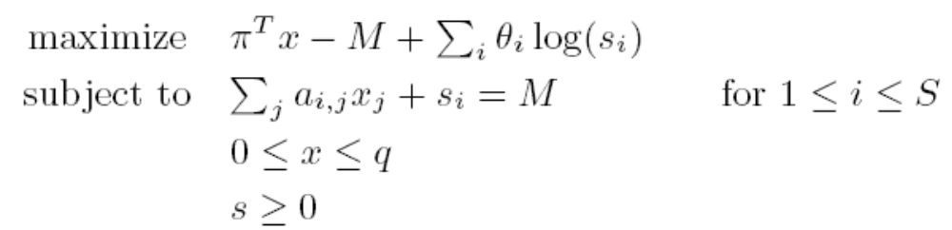
CPCAM Formulation
Peters, So and Ye [2005]
Convex Parimutuel Call Auction Market (CPCAM) Model
  Formulation
  Characteristics
    Convex formulation
    Self-funding
    Price consistency
    No estimate of state probabilities needed
    Multi-lateral order matching
    Same solution for different prices charged to participants
    Unique state prices
    Unique limit for the state prices (stronger demonstration of self-funding)
    Identical solution to the PMM
  Issues
    Market is run as a call auction (no real time decisions)
a_{i,j} - State bid (either 1 or 0)
q_{j} – Limit quantity
π_{j} – Limit price
p_{i} – State price
x_{j} – Order fill

Slide 13
CPCAM Formulation
Peters, So and Ye [2005]
Interpretation of Objective Function
a_{i,j} - State bid (either 1 or 0)
q_{j} – Limit quantity
π_{j} – Limit price
p_{i} – State price
x_{j} – Order fill
Profit
Penalty for non-parimutuel solution

